Slide 1

Week 6 -7 : Model Building and Training
Priyanka Patil

Slide 2
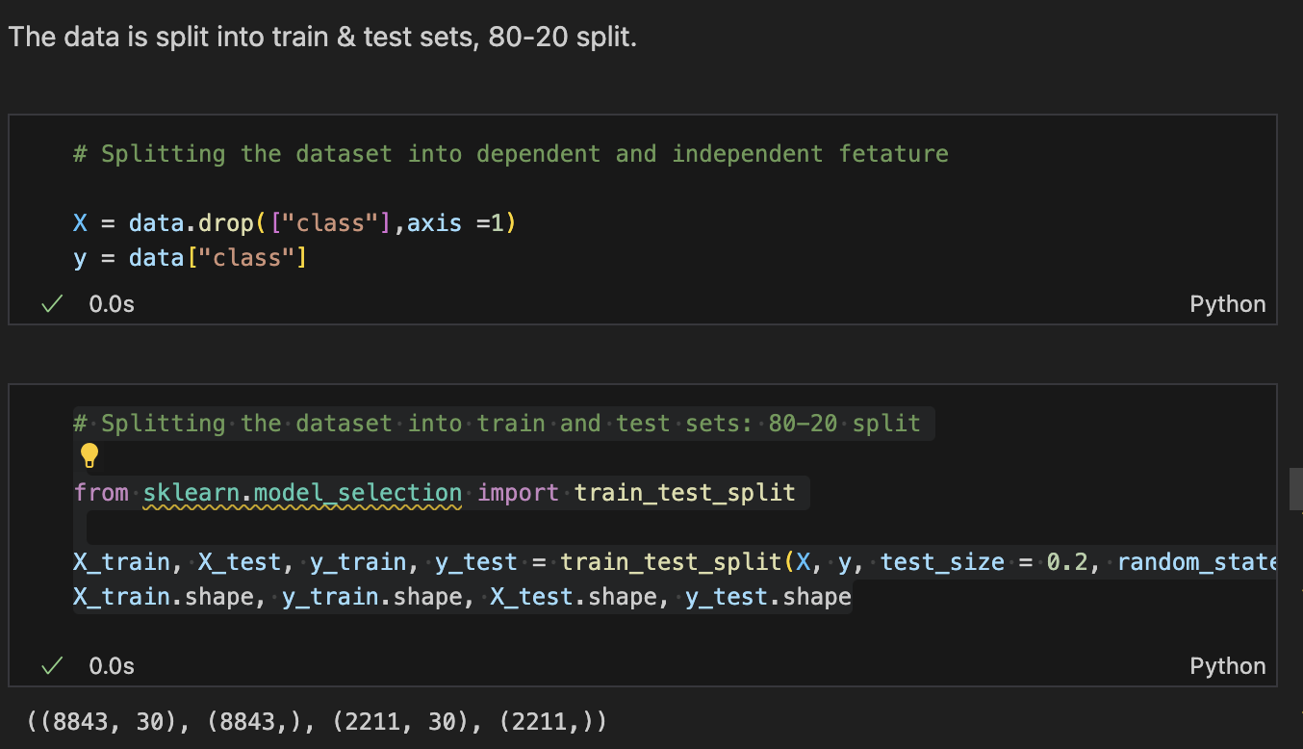
Splitting the Data

Slide 3
train_test_split takes the features X and the target y as inputs and splits them into training (X_train, y_train) and testing (X_test, y_test) sets.
test_size = 0.2 indicates that 20% of the data should be used as the test set, with the remaining 80% used for the training set.
random_state = 42 sets a seed for the random number generator used for the split. This ensures that the split is reproducible; that is, running this code multiple times will always produce the same split, which is important for debugging and comparing model performance.
X_train: The feature matrix for training the model.
y_train: The corresponding labels for the training data.
X_test: The feature matrix for testing the model.
y_test: The corresponding labels for the test data.

Slide 4
Model Building and training
Supervised machine learning is one of the most commonly used and successful types of machine learning. Supervised learning is used whenever we want to predict a certain outcome/label from a given set of features, and we have examples of features-label pairs. We build a machine learning model from these features-label pairs, which comprise our training set. Our goal is to make accurate predictions for new, never-before-seen data.
The supervised machine learning models considered to train the dataset in this notebook are:
1. Logistic Regression
2. k-Nearest Neighbors
3. Support Vector Classifier
4. Naive Bayes
5. Decision Tree
6. Random Forest
7. Gradient Boosting
8. Catboost
9. Xgboost
10. Multilayer Perceptrons

Slide 5
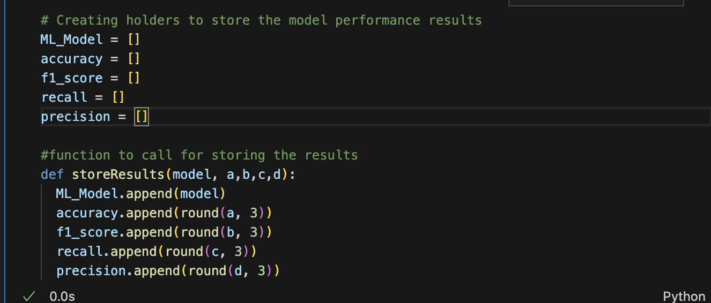
Storing Model Performance

Slide 6
Variables for Storing Model Performance:
ML_Model: A list to store the names or identifiers of the machine learning models evaluated.
accuracy: A list to store the accuracy scores of the models. Accuracy measures the proportion of correct predictions among the total number of cases processed.
f1_score: A list to store the F1 scores of the models. The F1 score is the harmonic mean of precision and recall, providing a balance between the two for models where false negatives and false positives are crucial.
recall: A list to store the recall scores of the models. Recall, or sensitivity, measures the proportion of actual positives correctly identified.
precision: A list to store the precision scores of the models. Precision measures the proportion of positive identifications that were actually correct.

Slide 7
Function for Storing Results
storeResults(model, a, b, c, d): A function defined to streamline the process of recording the performance metrics of each machine learning model into the respective lists. It takes five parameters:
model: The name or identifier of the machine learning model.
a: The accuracy score of the model.
b: The F1 score of the model.
c: The recall score of the model.
d: The precision score of the model.

Slide 8
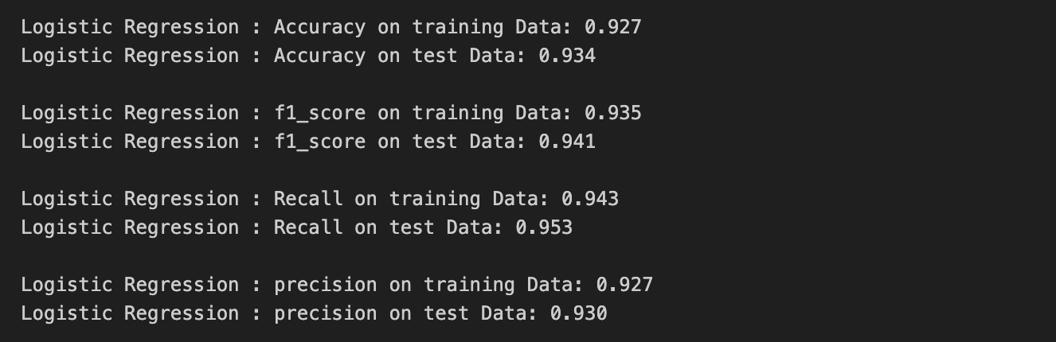
Logistic Regression
Logistic Regression is utilized for binary classification tasks, where the outcome is discrete. In our phishing detection project, it helps to categorize websites as either phishing (-1) or legitimate (1).
It works by estimating probabilities using a logistic function, which is particularly useful when the relationship between the independent variables and the dependent variable is not linear.
The model has demonstrated commendable accuracy, precision, recall, and F1-score, indicating its robustness in classifying phishing attempts.

Slide 9
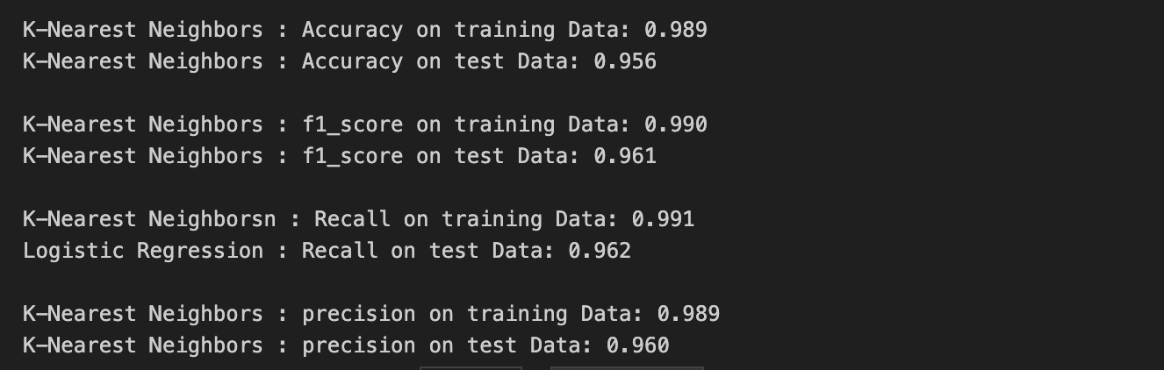
K- Nearest Neighbour
KNN is a non-parametric, instance-based learning algorithm that classifies new cases based on similarity measures with known instances.
It is intuitive and straightforward, making no assumptions about the data distribution, which is useful in our phishing detection where patterns can be complex.
With a high accuracy and F1-score, KNN has proven to be highly effective at distinguishing between the phishing and legitimate classes in our dataset.

Slide 10
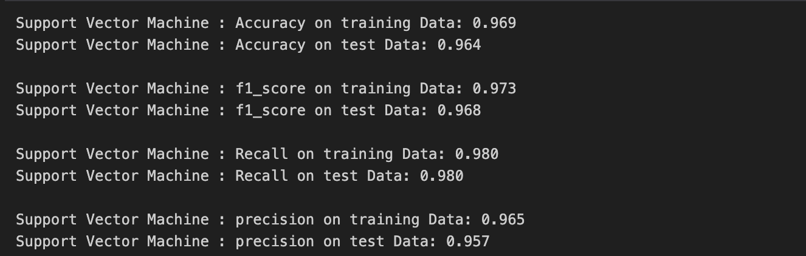
Support vector machine
SVM is a powerful classifier that works by finding the hyperplane that best separates the classes in a high-dimensional space, which is crucial for the nuanced differentiation needed in phishing detection.
It's capable of both linear and non-linear classification, thanks to the kernel trick, which allows for flexibility in dealing with various data structures.
Our model, optimized through grid search for parameters like 'gamma' and 'kernel', shows high accuracy and F1-scores, suggesting a strong predictive performance.

Slide 11
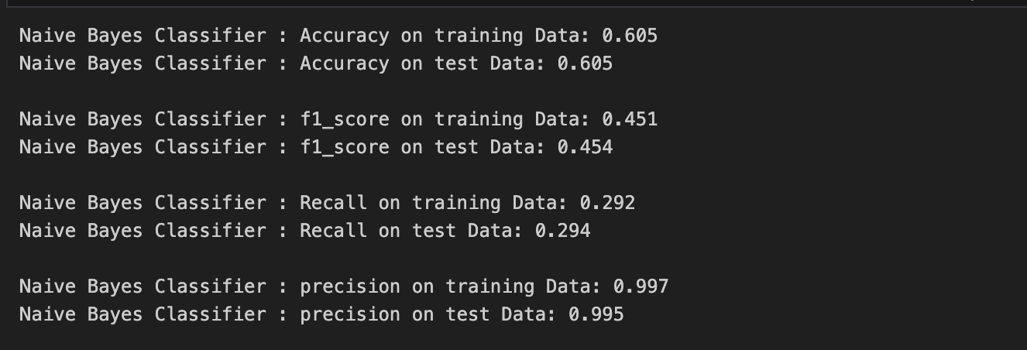
Naïve Bayes Classifier
The Naive Bayes algorithm applies Bayes' theorem with strong (naive) independence assumptions between the features. It's especially popular for text classification problems due to its simplicity and efficiency.
Despite its assumption of feature independence, which may not hold true in complex datasets like phishing detection, it can still provide a solid baseline for performance.
In our project, Naive Bayes shows lower accuracy and F1-score compared to other models but boasts a near-perfect precision, demonstrating its potential to be a fast, initial filter in a more extensive classification system.

Slide 12

Week 7- Building models
DECISION TREE CLASSIFIER
RANDOM FOREST CLASSIFIER
GRADIENT BOOSTING CLASSIFIER
MLP CLASSIFIER
COMPARING MODELS AND SORTING BASED ON ACCURACY

Slide 13
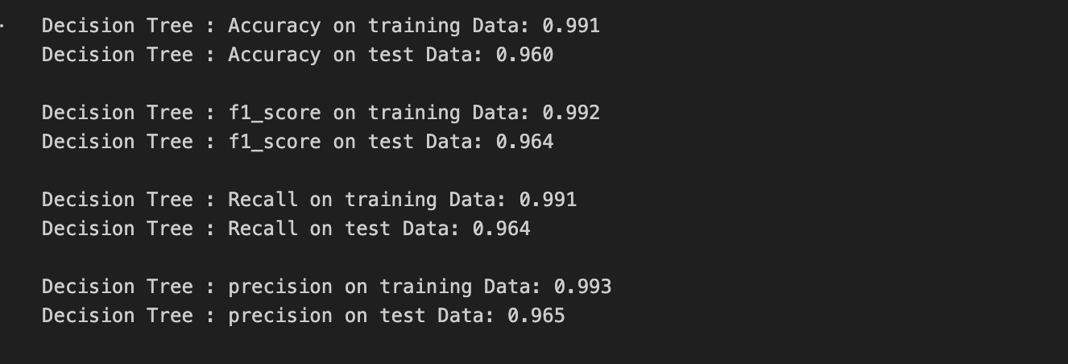
Decision trees classifier
When applying a Decision Tree Classifier to phishing website detection, the algorithm analyzes the dataset to find the features that best separate phishing sites from legitimate ones. This process involves:
Feature Selection: At each step or node of the tree, the algorithm selects one feature that best splits the data into classes. The selection criterion is often based on metrics like information gain, Gini impurity, or chi-square. For phishing detection, the algorithm evaluates how well each feature (e.g., URL length, use of HTTPS, presence of IP address) separates phishing sites from legitimate ones.
Decision Making: Based on the selected feature, the algorithm applies a decision rule that splits the data into two or more subsets. For example, if the selected feature is URL length, the decision rule might be "Is the URL length greater than 54 characters?". Websites will then be divided into two groups based on their URL length, with each group representing either a closer step towards being classified as phishing or legitimate.
Tree Depth and Complexity: The process continues with further splits at each branch, considering other features and applying new decision rules. The depth of the tree (i.e., the number of splits) depends on the complexity of the data and the differentiation required to accurately classify the websites. Too deep trees might overfit the data, capturing noise rather than the underlying pattern.
Terminal Nodes (Leaves): The process ends when a node has records from only one class, or when it meets a stopping criterion set to prevent overfitting. Each leaf node represents a final decision: phishing or legitimate, based on the path of decisions taken from the root to that leaf.

Slide 14
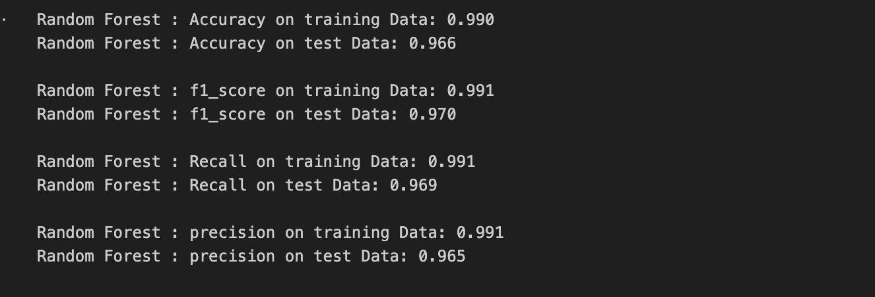
Random forest classifier
Random Forest model would be trained on features such as URL length, age of domain, SSL certificate validity, use of IP address in the URL, and many others. Each tree in the forest makes a prediction based on a random subset of these features and a random subset of the training data. The overall prediction is then made based on the majority vote across all trees. This approach allows the model to capture complex patterns and interactions among features that might indicate phishing activity, making it highly effective for cybersecurity applications.

Slide 15
How does this model Work:
Imagine we are tasked with creating a model to detect phishing websites based on various features like URL length, if the site uses HTTPS, the presence of an IP address in the URL, the age of the domain, etc. Here's how Random Forest might approach this:
Creating Subsets of Data:
Random Forest starts by selecting random subsets of the data for each tree. For instance, for detecting phishing websites, one tree might get trained on samples mostly with long URLs, another on domains registered recently, and so on.
Building Decision Trees:
For each subset of data, a decision tree is constructed. Each tree makes its decision based on the features it was trained on. One tree might learn that sites with very long URLs and lacking HTTPS are likely phishing sites. Another tree might focus on the age of the domain and specific keyword presence in the URL.
Making Predictions:
To make a prediction, each tree in the forest gives its vote. For example, when a new website is being evaluated, one tree might classify it as phishing based on its URL length, another might focus on the lack of HTTPS, and so on.
Aggregating Results:
The Random Forest aggregates votes from all trees. If the majority classify the website as phishing, the ensemble model labels it as such. Conversely, if most trees think the site is legitimate, the model will lean towards classifying it as safe.
Outcome:
Suppose we have a website that has a long URL, doesn't use HTTPS, and the domain was registered very recently. Most of our trees, having learned different aspects of what makes a site likely to be phishing, vote for this site to be phishing. The aggregated result is a high confidence classification of the site as a phishing attempt.

Slide 16
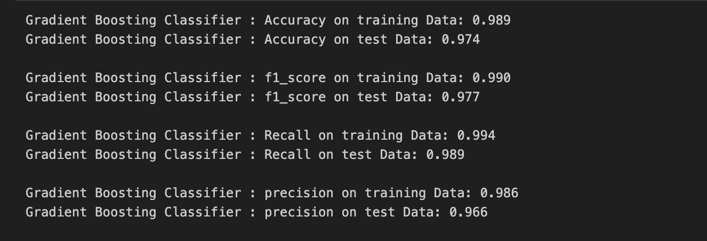
Gradient boosting classifier
The Gradient Boosting Classifier is a powerful tool for detecting phishing websites, leveraging a methodical approach to build a series of decision trees that correct each other's errors. It uniquely focuses on instances that are challenging to classify, adapting to the subtleties of phishing tactics. By optimizing the loss function, it emphasizes the importance of accurately identifying phishing attempts, penalizing false negatives to minimize security risks. This model stands out for its ability to handle complex non-linear relationships between features, enabling it to detect sophisticated phishing schemes with high accuracy. Its adaptability and continuous learning from data make it exceptionally effective in the evolving landscape of cybersecurity threats.

Slide 17
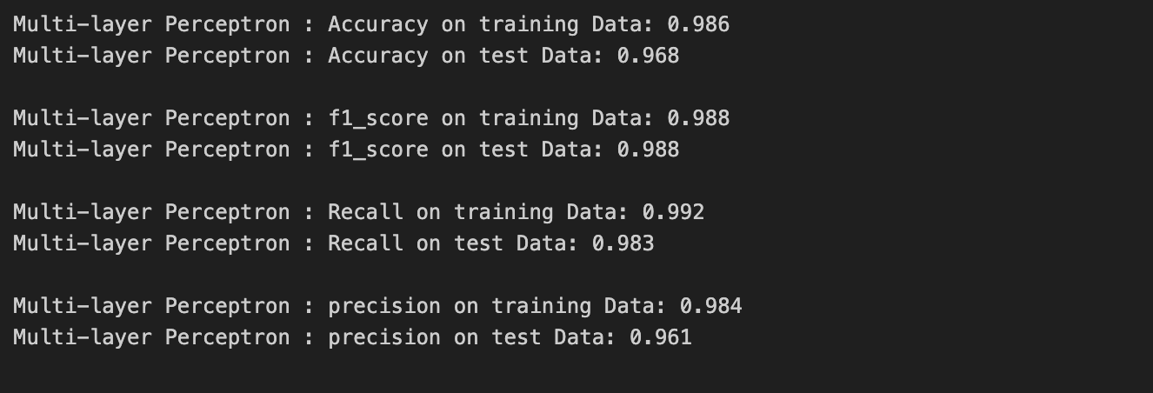
MLP classifier
The Multilayer Perceptron (MLP) Classifier, a type of neural network, is adept at identifying complex patterns and relationships within data through its multiple layers of nodes or neurons. When applied to phishing website detection, the MLP Classifier processes various features of websites, such as URL structure, use of HTTPS, presence of suspicious tokens, and more, through its interconnected layers to discern between legitimate and phishing sites.
How It Works in Phishing Website Detection:
Let’s say a new website is presented to the model with the following features: a long URL, no HTTPS, and a recently registered domain. The MLP processes these inputs through its layers, considering learned patterns from the training phase. The output layer might produce a high probability for the phishing class based on the model's learned weights, suggesting that the website is likely a phishing site.

Slide 18
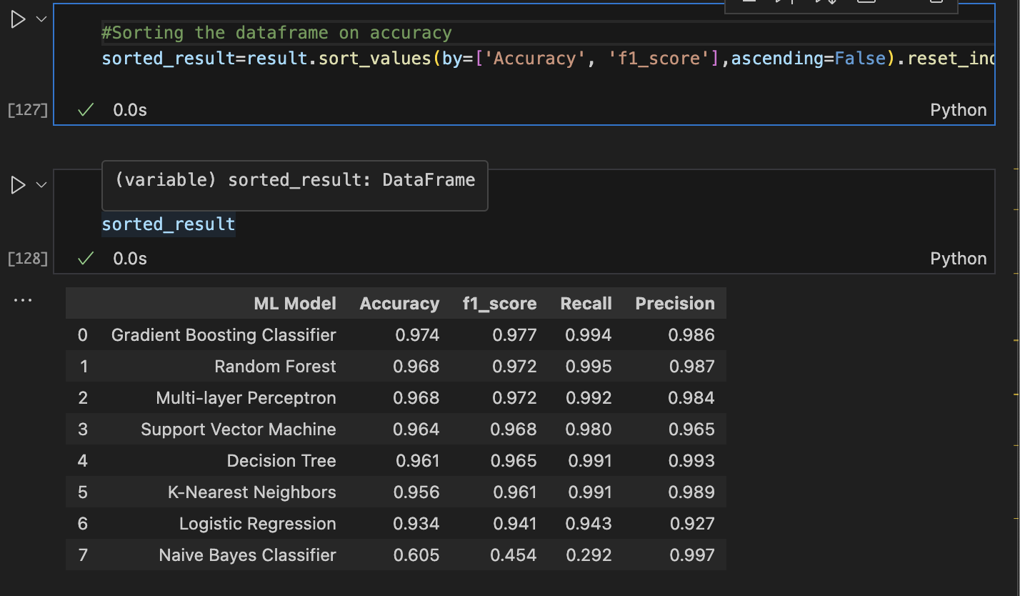
Sorting models based on accuracy

Slide 19
Week 8 – Storing the best model results and Working on GUI to be continued….

Slide 20
Sorting models based on Testing Data accuracy

Slide 21
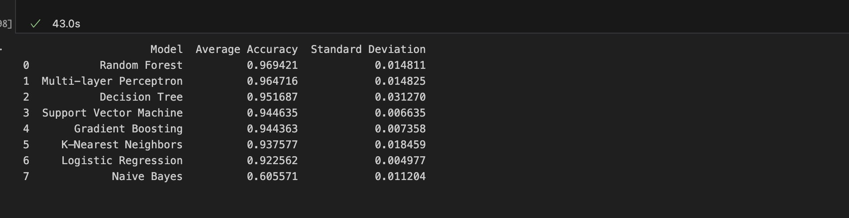
5-FOLD CROSS VALIDATION RESULTS

Slide 22
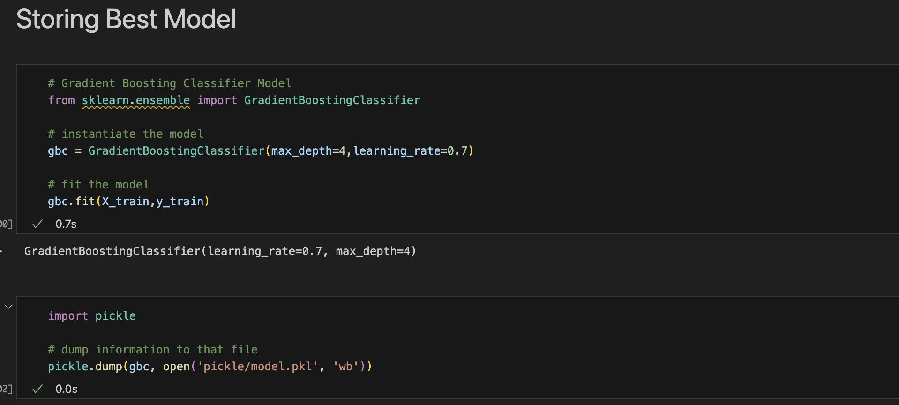
STORE THE BEST MODEL

Slide 23
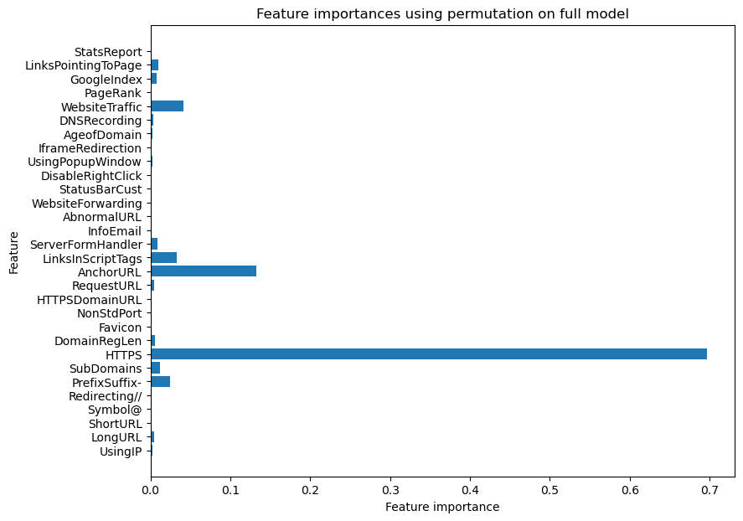

Slide 24
FLASK APPLICATION
WORKING ON THE CODING PART TO HANDLE FORM SUBMISSION AND INTEGRATE MODEL FOR PREDICTIONS.

Slide 25
